Slide 1
MARC cF

Slide 2
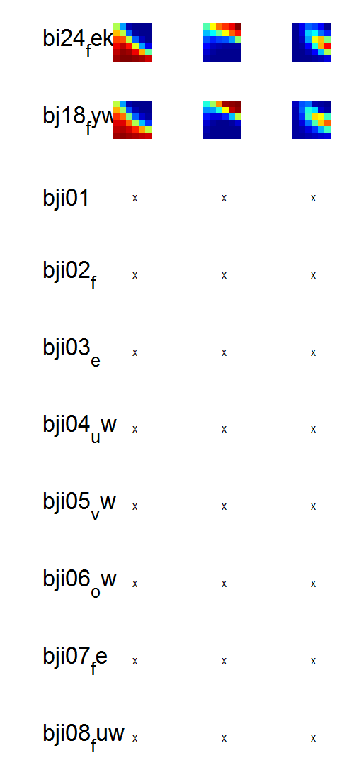
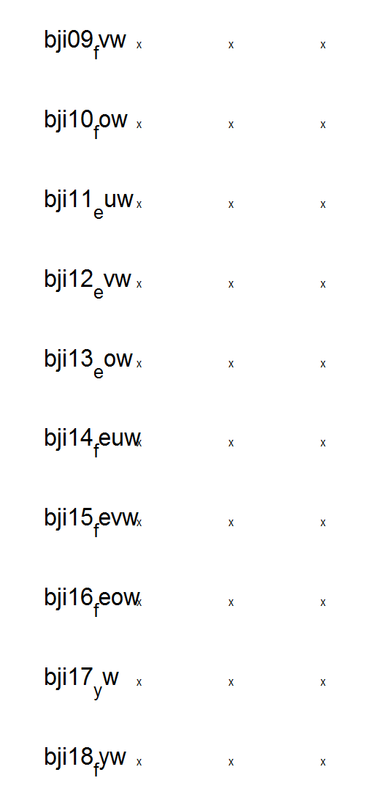
D:\Dropbox\SANDISK\4 Explore experiment\3 Analysis\4 Fit computational models\2 Analysis inputs\3 Hierarchical
res_hierarfitmodels_cF (16-Apr-2015) all
Transform = 0

Slide 3
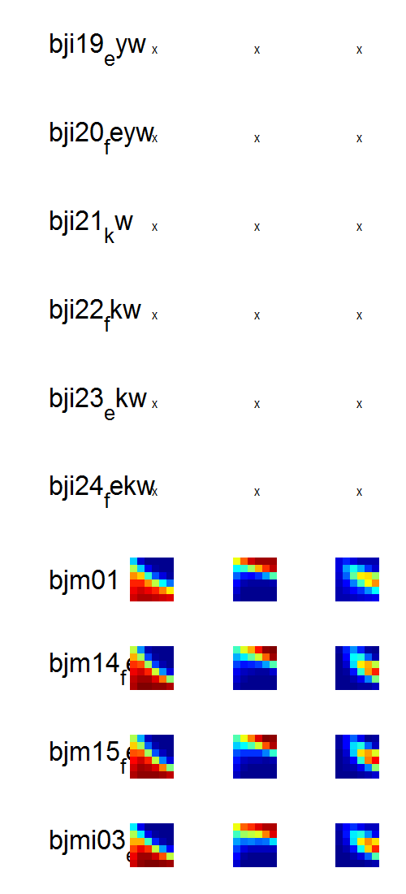
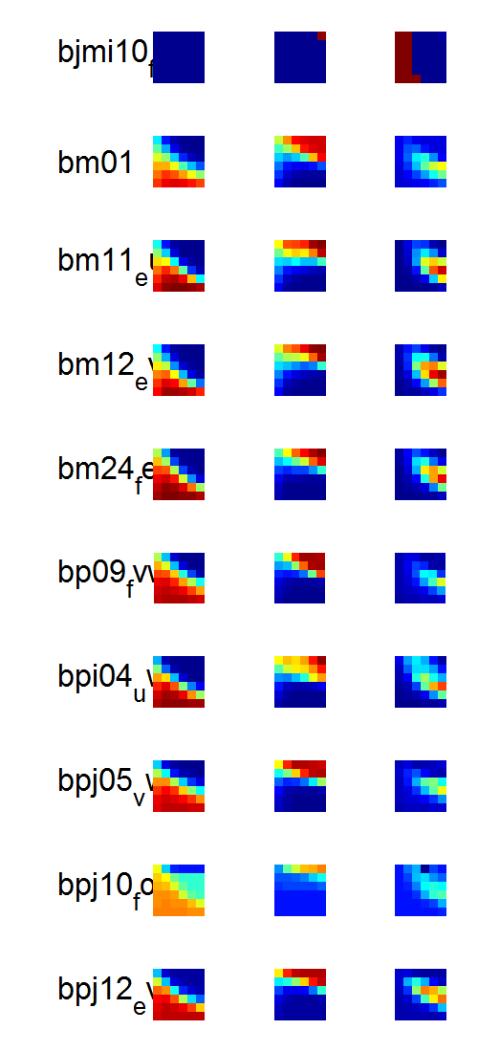
D:\Dropbox\SANDISK\4 Explore experiment\3 Analysis\4 Fit computational models\2 Analysis inputs\3 Hierarchical
res_hierarfitmodels_cF (16-Apr-2015) all
Transform = 0

Slide 4
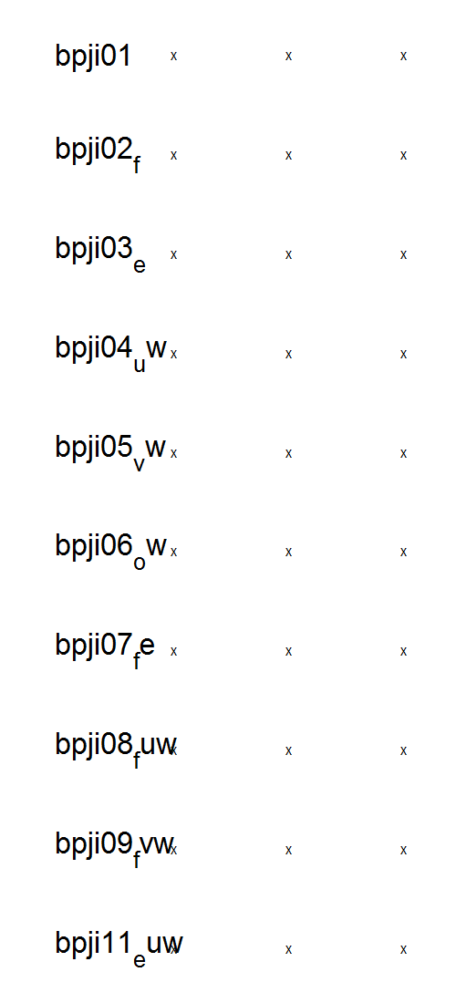
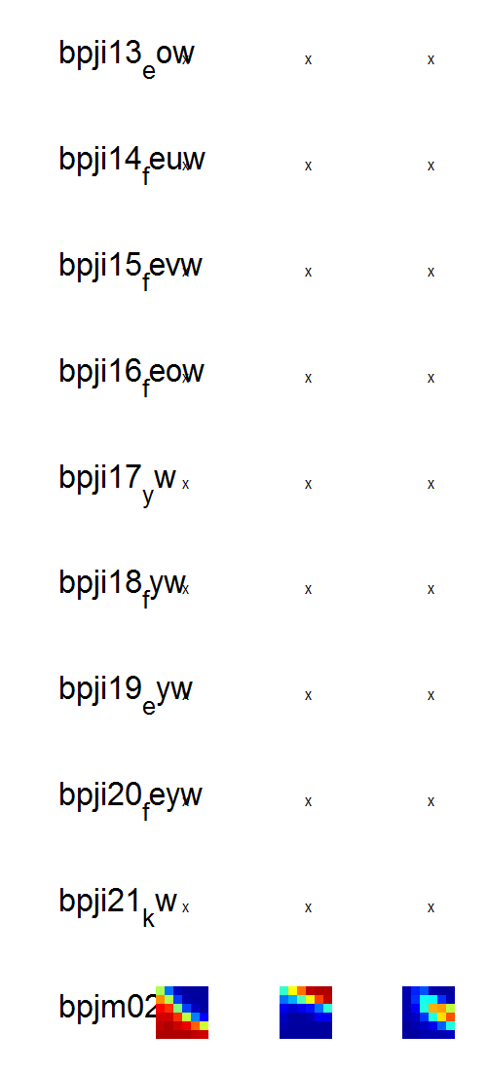
D:\Dropbox\SANDISK\4 Explore experiment\3 Analysis\4 Fit computational models\2 Analysis inputs\3 Hierarchical
res_hierarfitmodels_cF (16-Apr-2015) all
Transform = 0

Slide 5
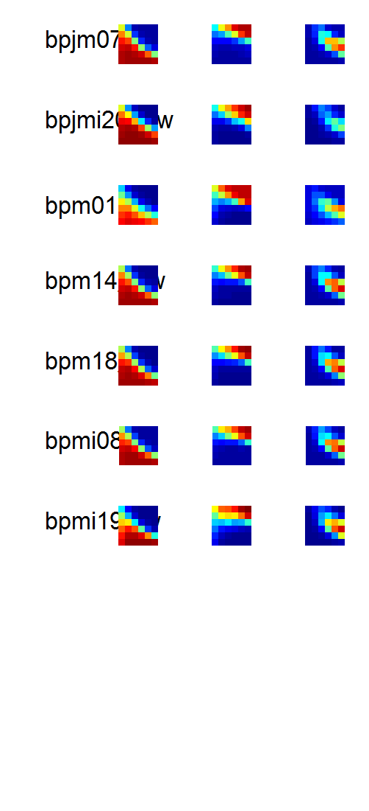
D:\Dropbox\SANDISK\4 Explore experiment\3 Analysis\4 Fit computational models\2 Analysis inputs\3 Hierarchical
res_hierarfitmodels_cF (16-Apr-2015) all
Transform = 0

Slide 6
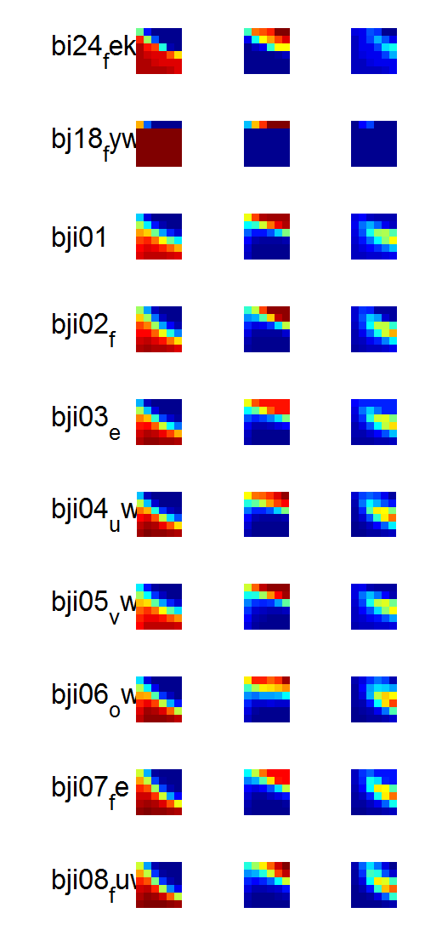
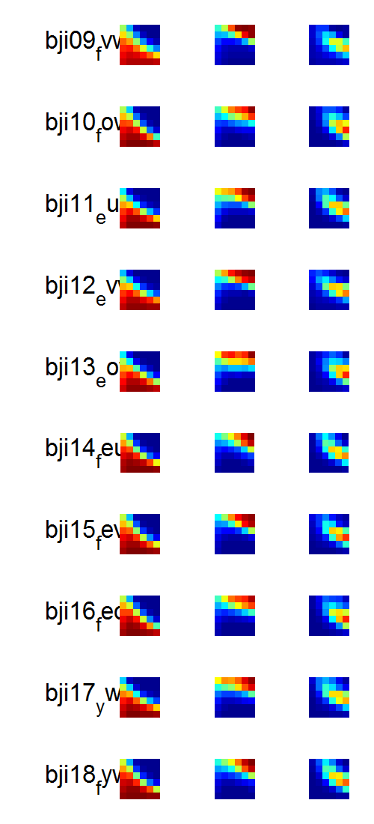
D:\Dropbox\SANDISK\4 Explore experiment\3 Analysis\4 Fit computational models\2 Analysis inputs\3 Hierarchical
res_hierarfitmodels_cF (16-Apr-2015) all
Transform = +1;

Slide 7
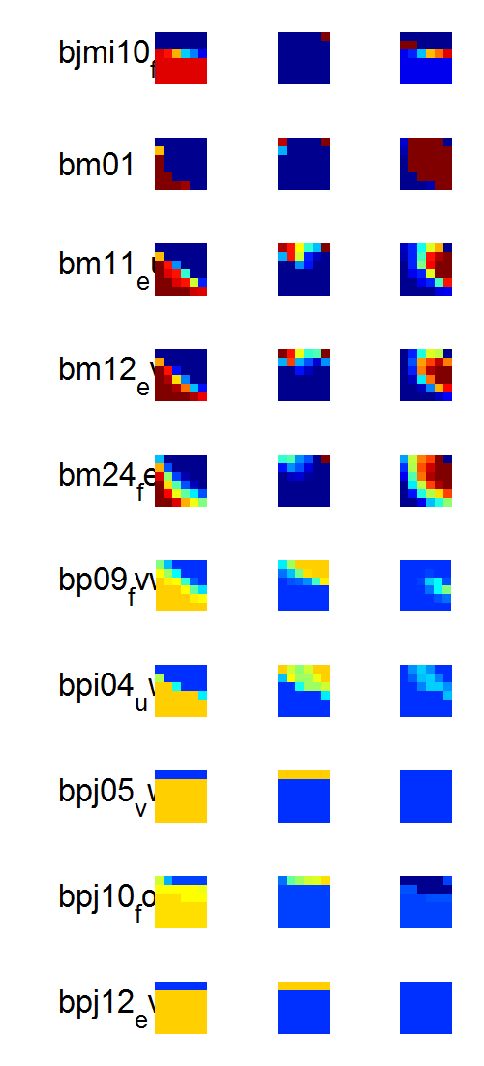
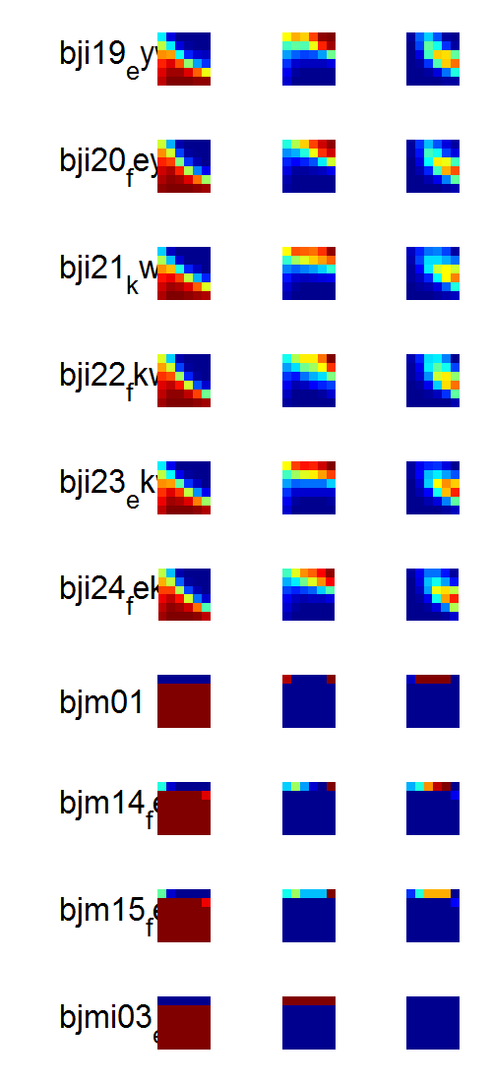
D:\Dropbox\SANDISK\4 Explore experiment\3 Analysis\4 Fit computational models\2 Analysis inputs\3 Hierarchical
res_hierarfitmodels_cF (16-Apr-2015) all
Transform = +1;

Slide 8
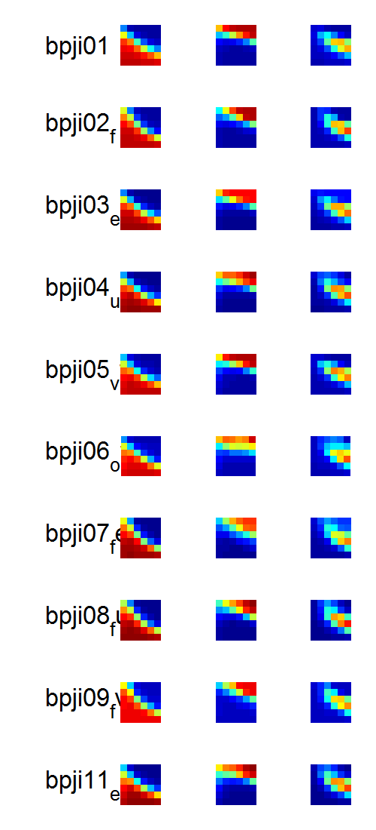
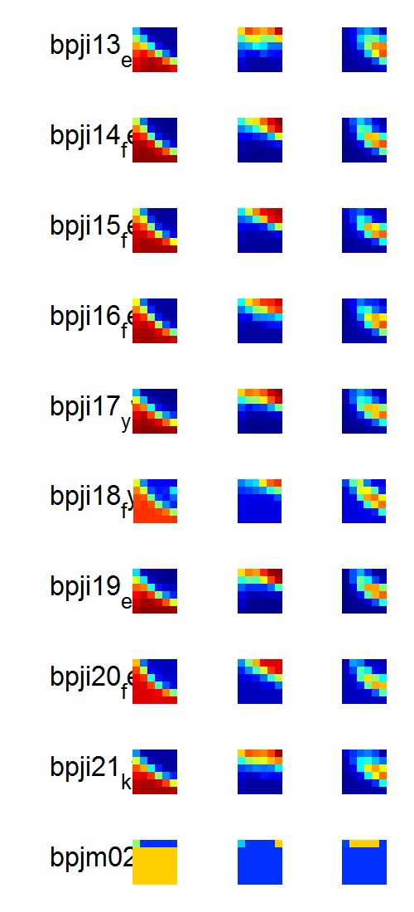
D:\Dropbox\SANDISK\4 Explore experiment\3 Analysis\4 Fit computational models\2 Analysis inputs\3 Hierarchical
res_hierarfitmodels_cF (16-Apr-2015) all
Transform = +1;

Slide 9
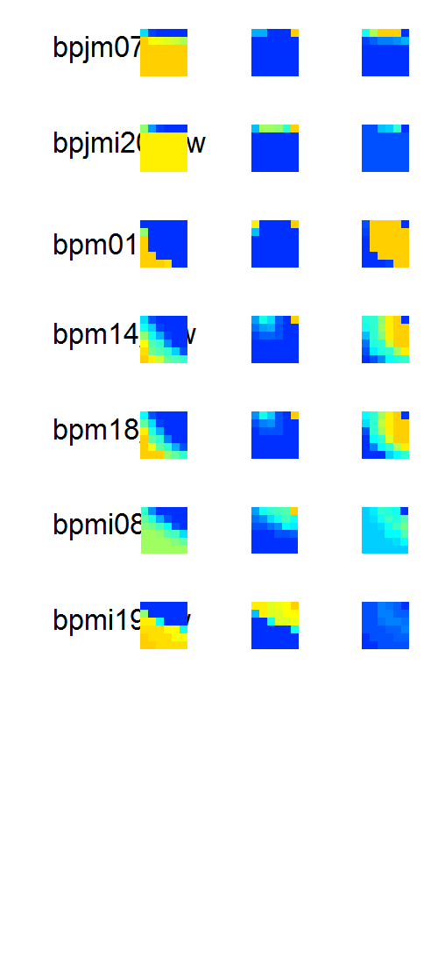
D:\Dropbox\SANDISK\4 Explore experiment\3 Analysis\4 Fit computational models\2 Analysis inputs\3 Hierarchical
res_hierarfitmodels_cF (16-Apr-2015) all
Transform = +1;

Slide 10
MARC ct

Slide 11
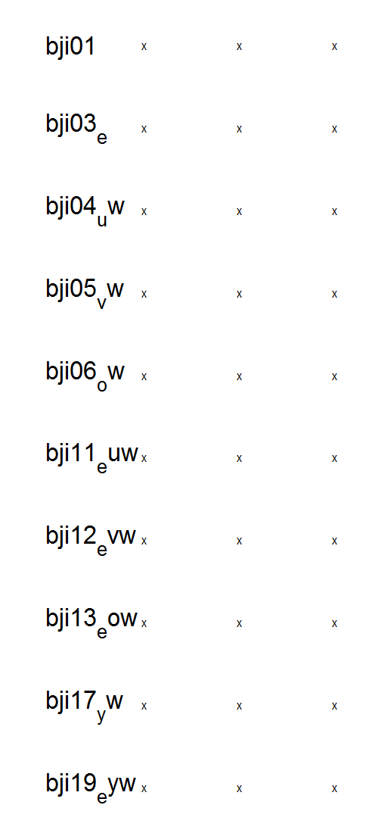
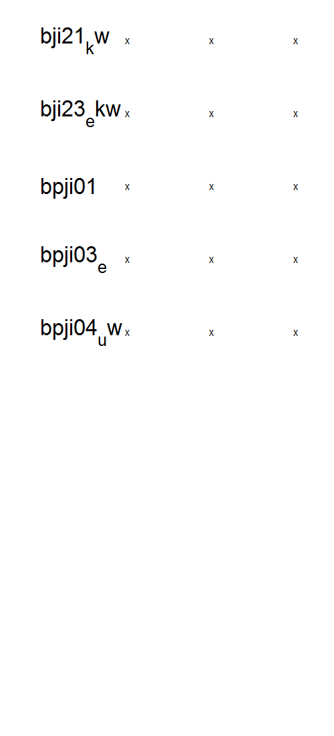
D:\Dropbox\SANDISK\4 Explore experiment\3 Analysis\4 Fit computational models\2 Analysis inputs\3 Hierarchical
res_hierarfitmodels_cF (16-Apr-2015) all
Transform = 0

Slide 12
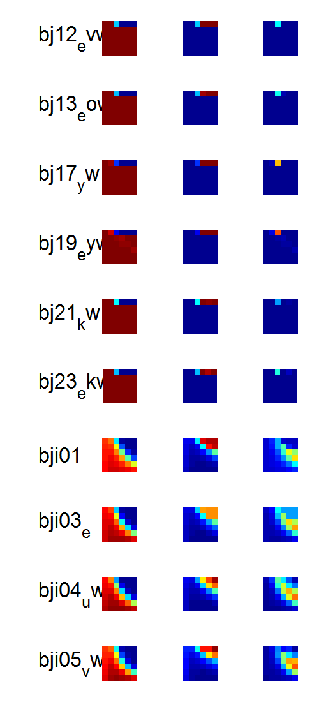
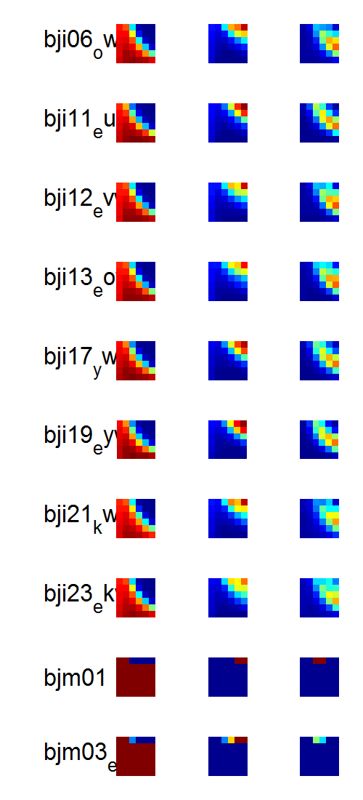
D:\Dropbox\SANDISK\4 Explore experiment\3 Analysis\4 Fit computational models\2 Analysis inputs\3 Hierarchical
res_hierarfitmodels_cF (16-Apr-2015) all
Transform = +1;

Slide 13
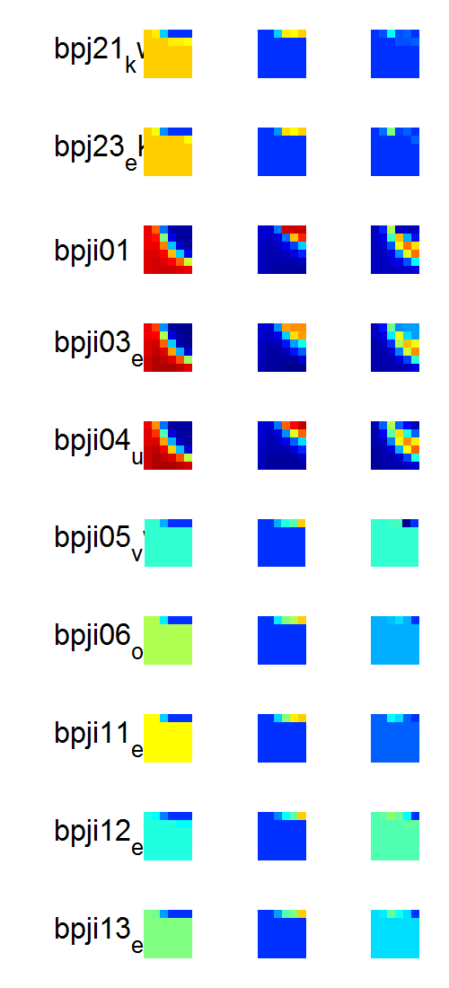
D:\Dropbox\SANDISK\4 Explore experiment\3 Analysis\4 Fit computational models\2 Analysis inputs\3 Hierarchical
res_hierarfitmodels_cF (16-Apr-2015) all
Transform = +1;
Follow up ONLY on the ones that look ok for transform +1. I think the rest are okay.

